Slide 1
Базы данных. JDBC. Построение запросов к базе на Java.
Лавринов Сергей
Урок 2

Slide 2
JDBC
The JDBC API is the industry standard for database-independent connectivity between the Java programming language and a wide range of databases. The JDBC API provides a call-level API for SQL-based database access. JDBC technology allows you to use the Java programming language to exploit "Write Once, Run Anywhere" capabilities for applications that require access to enterprise data.
JDBC API Overview
The JDBC API makes it possible to do three things: Establish a connection with a database or access any tabular data source
Send SQL statements
Process the results

Slide 3
Запросы
Statement
PreparedStatement
CallableStatement
Batch запрос

Slide 4
JDBC 4.0
Начиная с JDBC 4.0:
Конструкция:
Class.forName(“org,jdbc.SomeJDBCDriver"); пример: Class.forName("com.mysql.jdbc.Driver")
Стала не нужна
DriverManager.getConnection(“"); сам находит нужный драйвер
he DriverManager methods getConnection and getDrivers have been enhanced to support the Java SE Service Provider mechanism (SPM). According to SPM, a service is defined as a well-known set of interfaces and abstract classes, and a service provider is a specific implementation of a service. It also specifies that the service provider configuration files are stored in the META-INF/services directory. JDBC 4.0 drivers must include the file META-INF/services/java.sql.Driver. This file contains the name of the JDBC driver's implementation of java.sql.Driver. For example, to load the JDBC driver to connect to a Apache Derby database, the META-INF/services/java.sql.Driver file would contain the following entry:
org.apache.derby.jdbc.EmbeddedDriver

Slide 5
Новое:
JDBC data types: New JDBC data types, such as NCHAR, NVARCHAR, LONGNVARCHAR, and NCLOB were added.
PreparedStatement: New methods setNString, setNCharacterStream, and setNClob were added.
CallableStatement: New methods getNClob, getNString, and getNCharacterStream were added.
ResultSet: New methods updateNClob, updateNString, and updateNCharacterStream were added to ResultSet interface.

Slide 6
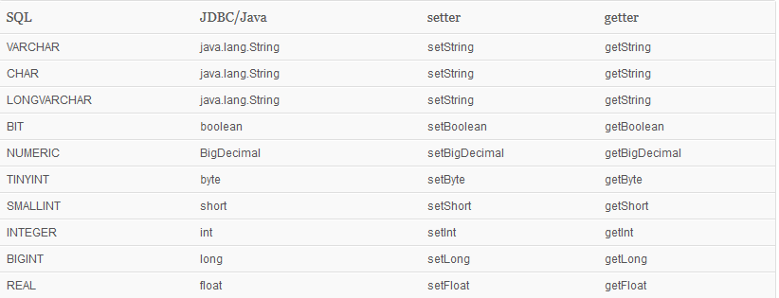
Типы данных

Slide 7
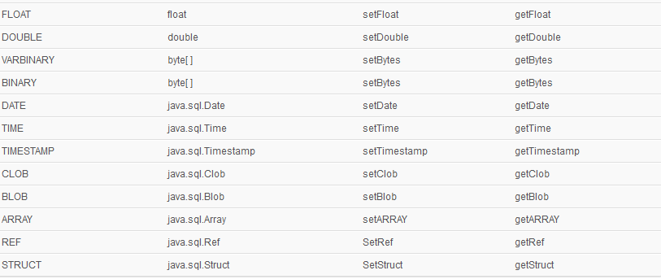
Типы данных

Slide 8
Объекты для работы с ResultSet
BaseRowSet
CachedRowSet
FilteredRowSet
JdbcRowSet
JoinRowSet

Slide 9
BaseRowSet
Абстрактный класс, который предоставляет базовую функциональность для работы с ResultSet

Slide 10
CachedRowSet
Это объект для строк данных которые сохранены в памяти, который позволяет работать с данными без соединения с базой данных. CachedRowSet соединяется с базой только когда считывает данные populate() или когда вносит в данные изменения.

Slide 11
Полезные ресурсы:
Паттерн DAO access object:
http://javatutor.net/articles/j2ee-pattern-data-access-object
Oracle javax.sql API:
https://docs.oracle.com/javase/8/docs/api/javax/sql/package-summary.html
SQLite
http://www.sqlite.org/
Java DB
http://www.oracle.com/technetwork/java/javadb/overview/index.htm

